Slide 1



Temporal data with tsibble and fable
Oskar Krafft
Justus v. Samson-Himmelstjerna
Notes:
Welcome to this short workshop about temporal data with tsibble

Slide 2


Outlook
tsibble: tidy data analysis workflow for time series data
tidy data frames combined with temporal data
fable: forecasting for time series datain a table format
Provide forecasts with time distributions, not intervals.
Specify
Tidy
Visualise
Estimate
Forecast
Evaluate
Notes:
In this Workshop we are introducing you to a workflow to wrangle and forecast time series data.

Slide 3
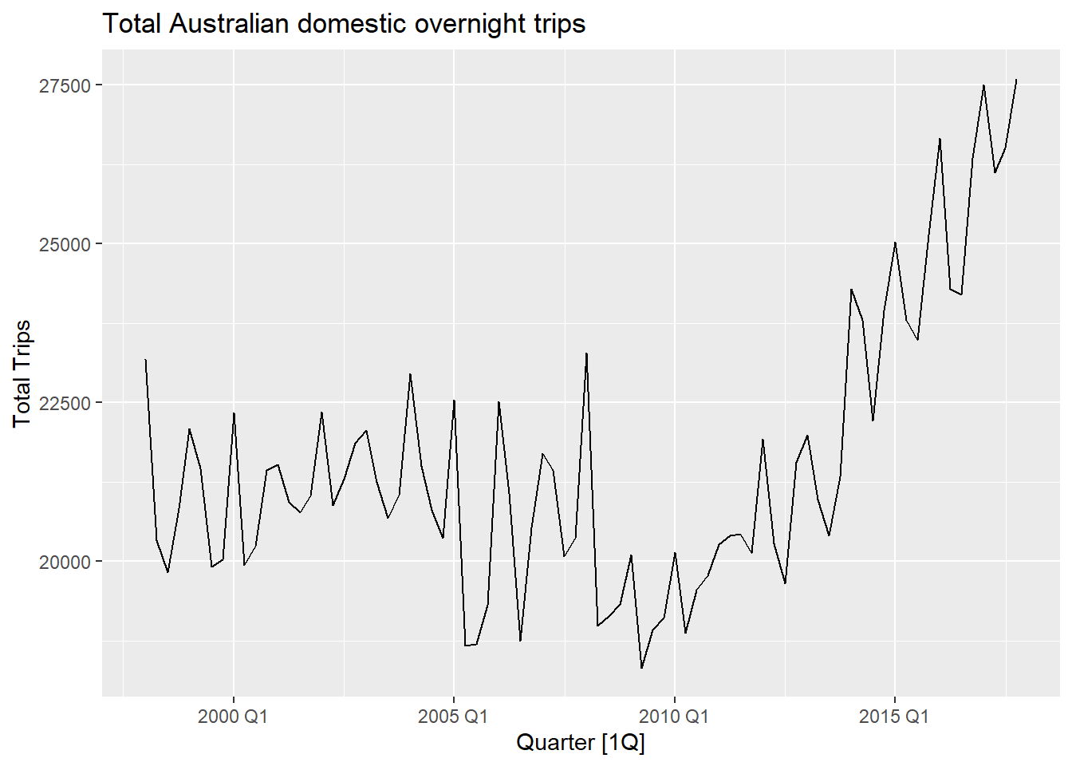
Vocabulary for time series analysis
Trends
Long-term overall increase or decrease in the Data
Does not have to be linear
Seasonal
Data affected by seasonal factors
Seasonality has fixed periods
Cyclic
Rises and falls of unknown frequency
For example economic cycles
Notes:
When we are looking at a graph, plotting temporal data like the one on the right, we can describe time series by analysing trends, seasonality and cycles
Trends describe long-term overall increase or decrease in the Data, which do not have to be linear
Seasonal effects are reoccurring increases or decreases within fixed and known time periods, such as Holidays or climatic seasons.
Cyclic effects are similar effects to seasonality however they are not bound to known frequencies or periods. Examples here would include economic crisis or business cycles
All over all time series can be thought of as a list of measurements, along some information about at what times those numbers were recorded and therefore creating an index.
We will now learn how to store this information within R as a tsibble and what we can do with those.

Slide 4
Grammar of tsibble
Index is a variable with inherent ordering from past to present.
Key is a set of variables that define observational units over time.
Each observation should be uniquely identified by index and key.
Interval computed from index, ranging from year to nanosecond, from numerics to ordered factors.
Intervals can be Regular as well as Irregular
Interval | Class
Annual | integer/double
Quarterly | yearquarter
Monthly | yearmonth
Weekly | yearweek
Daily | Date/difftime
Subdaily | POSIXt/difftime/hms
Notes:
The tsibble package provides a data class of tbl_ts to represent tidy temporal data. A tsibble consists of a time index, key, and other measured variables in a data-centric format, which is built on top of the tibble.
Within tsibble the Index and Key are used to uniquely identify each observation, keeping with the idea of the general tidy workflow.
Tsibble supports arbitrary index classes, as long as they can be ordered from past to future.
In comparison to tibble the column of data specifying the observation’s measurement time is now actually used in the data

Slide 5
Common verbs used in tsibble
as_tsibble() → Coerce Data to a tsibble object
count_gaps() → Count implicit gaps
fill_gaps() → Turn implicit missing values into explicit missing values
has_gaps() → Show if a tsibble has implicit gaps
filter_index() → filtering time index for a tsibble
index_by() → Group by time index and collapse with summarise()
group_by_key(). → Group by key variables

Slide 6
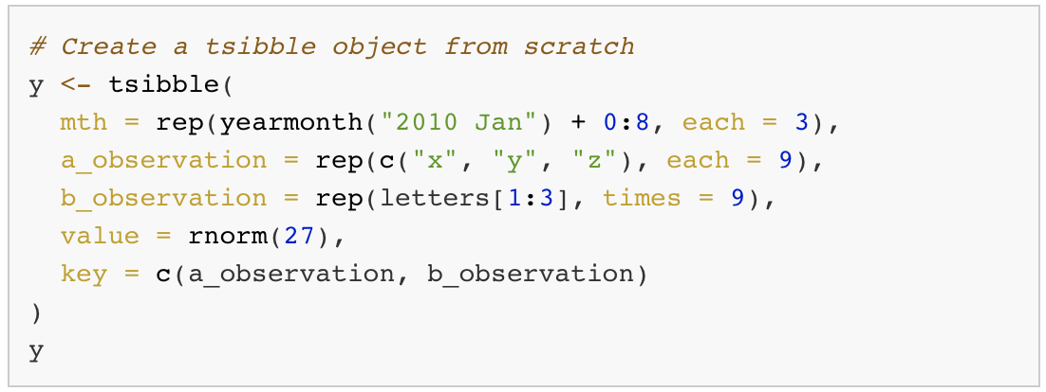
Data preparation and manipulation (tsibble)

Slide 7
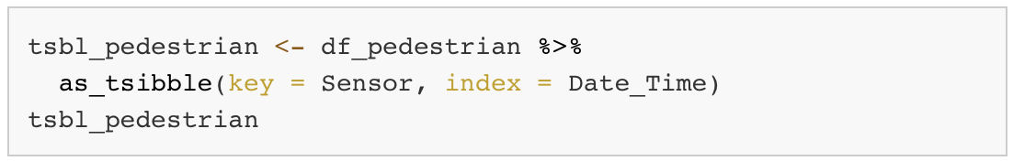
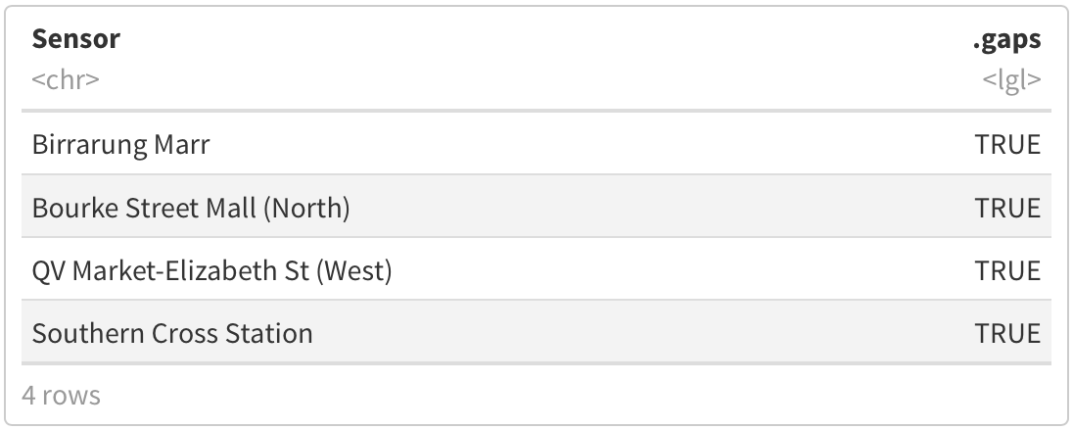
Data preparation and manipulation (tsibble)

Slide 8
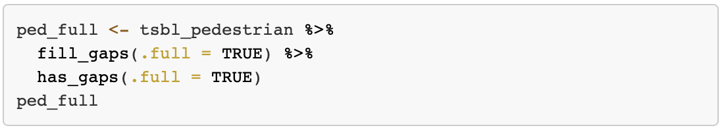
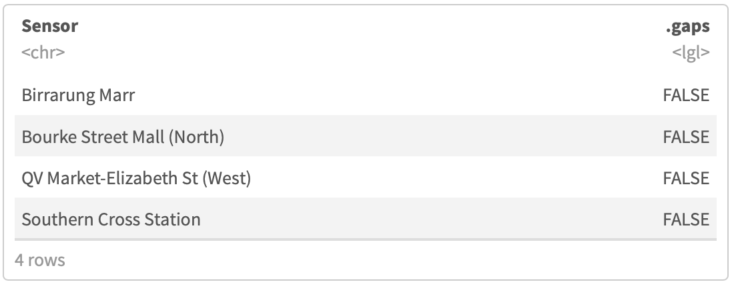
Data preparation and manipulation (tsibble)

Slide 9

A forecasting workflow for time series data
Data preparation and manipulation
Model specification and estimation
Forecasting and choosing the best Model

Slide 10
The syntax of fable
R> Transform(y) ~ {model specification}
Left Hand Side - Response | Right Hand Side - Specials
Defines the response variable from the Data | Model specific special functions
Specification of transformations (which are automatically back-transformed) | Several models at the same time possible

Slide 11
Common verbs used in fable
Model() → Model specification
ETS() → Exponential smoothing state space model
ARIMA() → Autoregressive integrated moving average model
TSLM() → Linear model with time series components
forecast() → Forecast Data using the specified model
glance() → Construct a single row summary of the model
accuracy() → Summarise the performance of the model using accuracy measures

Slide 12
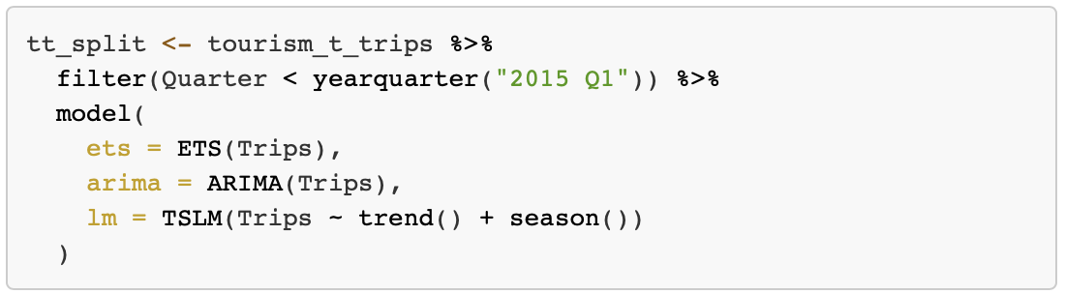
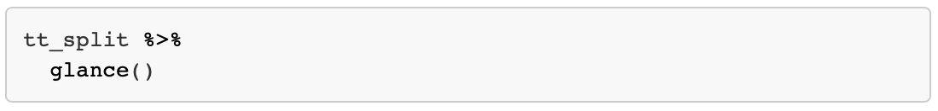
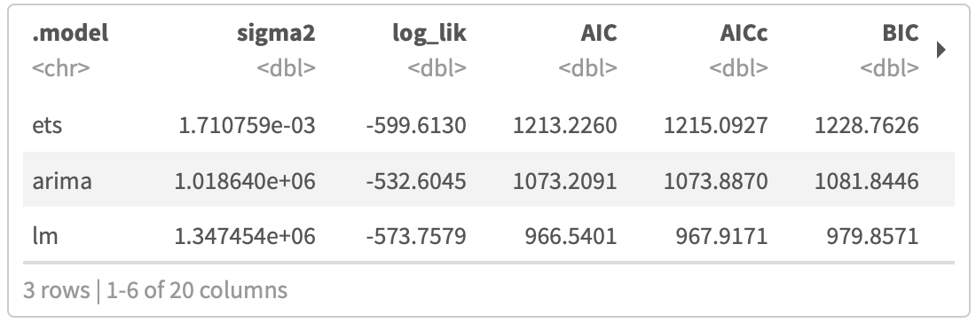
Model specification and forcasting (fable)
Notes:
.
Models in fable are specified using model functions
(y ~ X)
Response variable(s) are specified on the left of the formula
Structure of the model is written on the right
One or more model specifications can be estimated using the model() function.

Slide 13
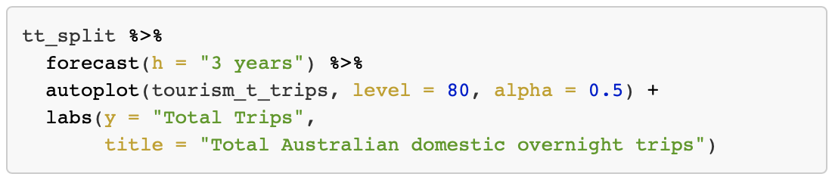
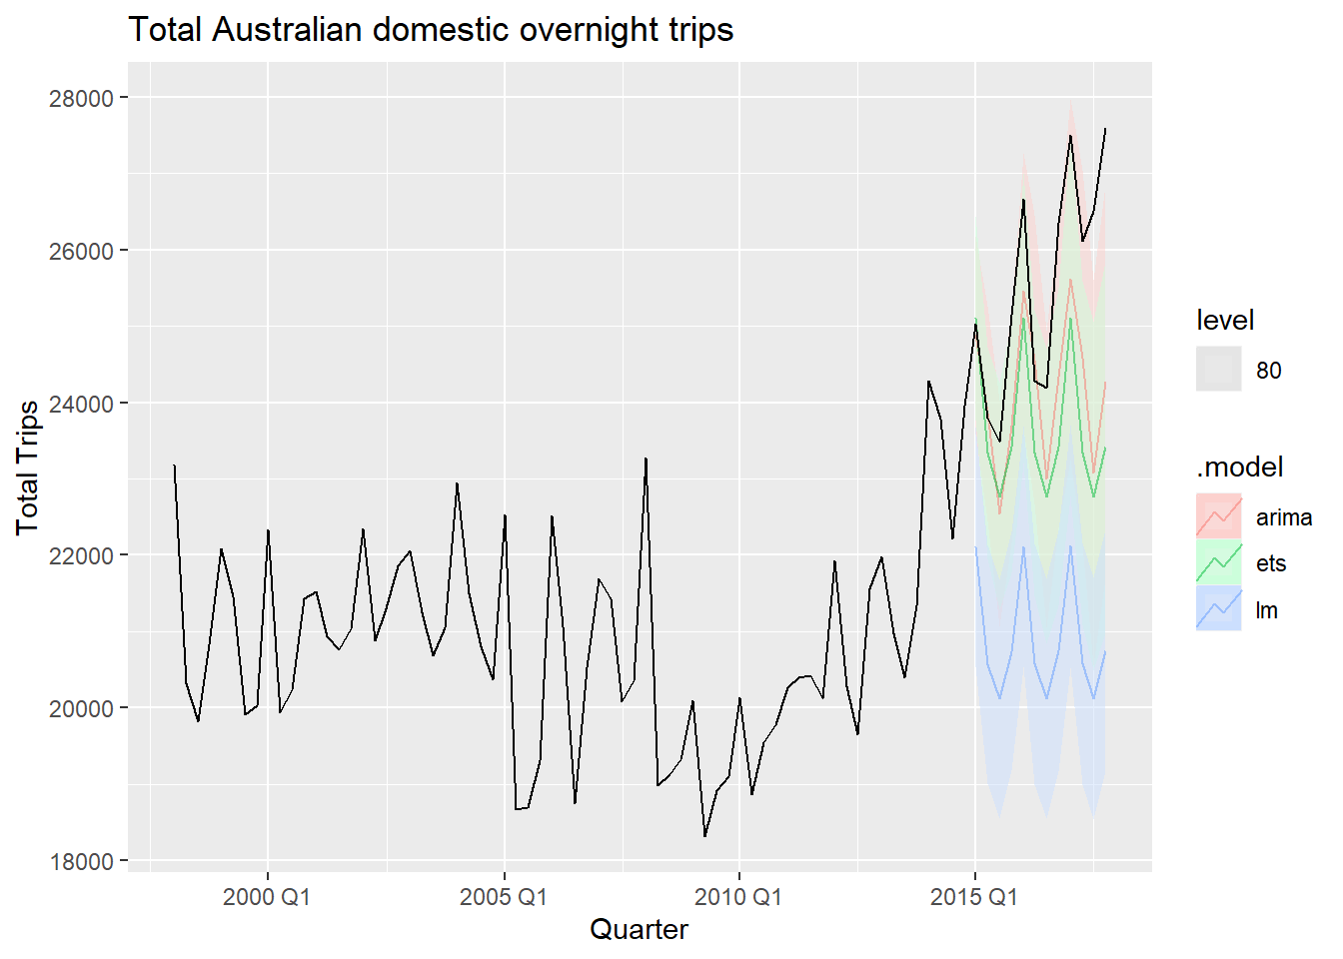
Producing forecasts
Notes:
.

Slide 14
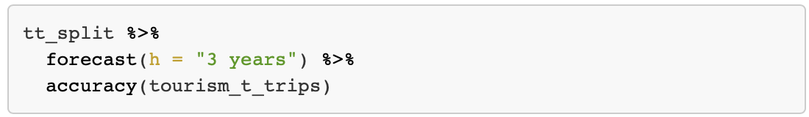
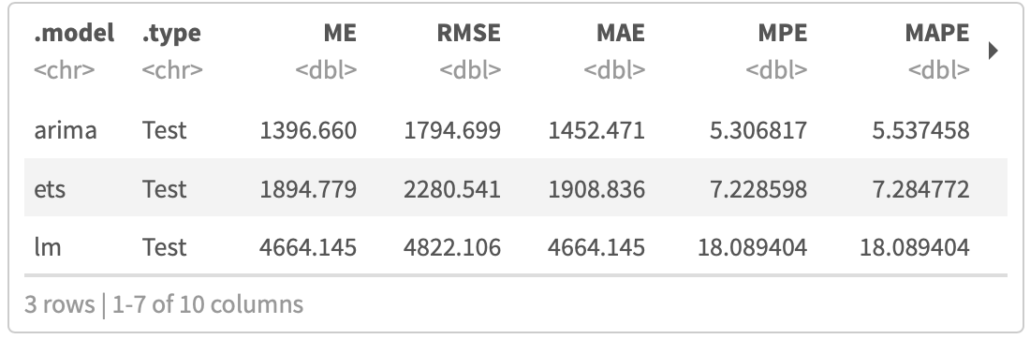
Producing forecasts
Notes:
.

Slide 15
What have we learned today?
Time series can be described by Trends, Seasonality, and Cycles.
The tsibble package provides a data class to represent tidy temporal data.
A tsibble consists of a time index, key, and other measured variables in a data-centric format.
Further packages are building upon tsibble to further analyse and visualise temporal data.
Fable helps forecasting for time series data in a table format.
Keeping with the tidyverse models in fable define the response variable on the left hand side and model specific functions on the right hand side.
Fable can be used to produce forecasts and asses how well different models perform.

Slide 16
Further Reading
Tidyverse Webpage for tsibble: https://tsibble.tidyverts.org
Tidyverse Webpage for fable: https://fable.tidyverts.org
Cran Webpage by the tsibble creator:
http://cran.nexr.com/web/packages/tsibble/vignettes/intro-tsibble.html
Cran package description for tsibble:
https://cran.r-project.org/web/packages/tsibble/tsibble.pdf
Cran package description for fable:
https://cran.r-project.org/web/packages/fable/fable.pdf
Introduction to fable by package creator:
https://www.mitchelloharawild.com/blog/fable/
Book by Rob J Hyndman on forecasting principles:
https://otexts.com/fpp3/

Slide 17
